Slide 1

Automation of register level code generation & execution for microcontroller validation
Presented by –
Sree Aslesh (BE/10440/15)
Mentor –
Puneetha Mukherjee
IFIN ATV MC D SW SVE
Infineon technologies, Bangalore

Slide 2
Contents
Introduction - Aurix TC3xx Series microcontroller
- Naming Pattern of the microcontroller
- Local Interconnect network
- Peak and Canalyzer devices
-
Literature Review
Motivation
Objectives
Progress and Deadlines

Slide 3
Introduction
Before a microcontroller is launched in the market, the most important phase is the microcontroller testing and validation.
The microcontrollers go through the process called regression in which a single test case is tested with multiple parameters and in multiple variations and hence the name regression.
The amount of man hours invested into writing codes which are used only once to validate the test cases regressively is very high. The approximation can be made as shown.
1 Code / Module = 40 Man hours
20 Modules = 800 Man hours
15 variations approx. ~ 12,000 Man hours
The following when divided across a team comes down to at least 45 Man days of work.
[1] - https://www.researchgate.net/post/What_is_the_percentage_of_the_PID_algorithm_applications_in_industry

Slide 4
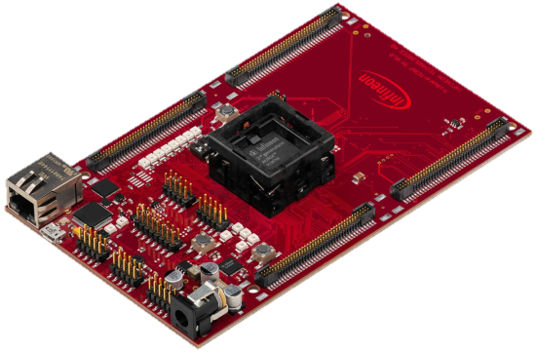
Aurix TC3xx Series Microcontroller
Infineon Technologies AURIX TC3xx Microcontrollers offer a high level of integration and real-time performance, serving the requirements of automated cars and electric vehicles.
With its high-performing hexa-core architecture and its
advanced features for connectivity, security and
embedded safety, the AURIX family TC3xx is ideally
suited for a wide field of automotive applications.
In addition to engine management and transmission control, powertrain applications include new systems in electrical and hybrid drives. Specifically hybrid domain control, inverter control, battery management, and DC/DC converters will benefit from the new architecture.
The AURIX TC3xx microcontrollers are well-suited to safety-critical applications ranging from airbag, braking and power steering to sensor-based systems using radar or camera technologies.

Slide 5
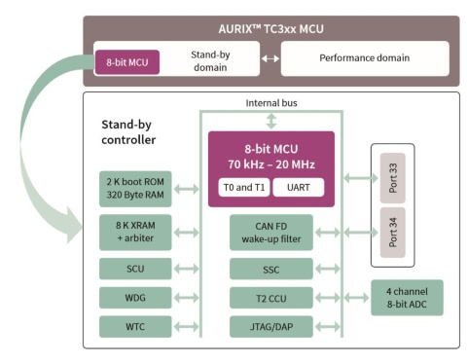

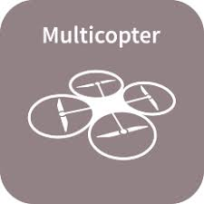


Aurix TC3xx Series Microcontroller Architecture & Applications

Slide 6
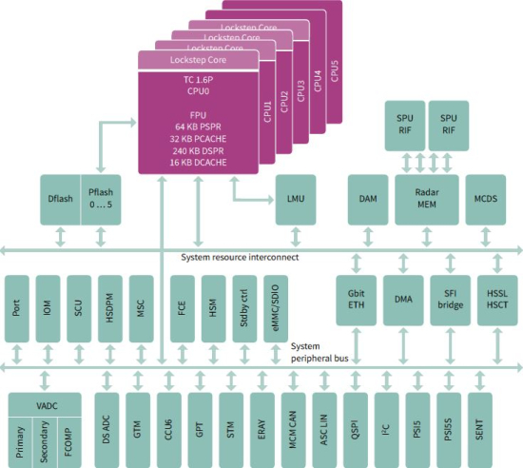
Microcontroller modules

Slide 7
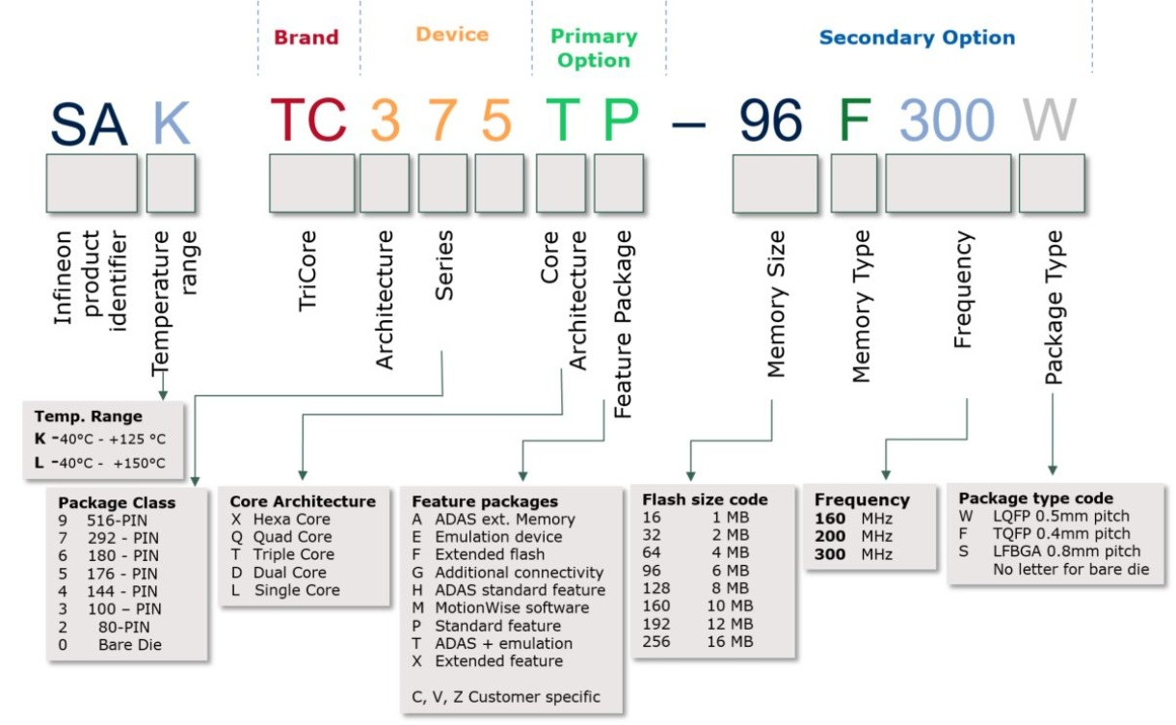
Naming pattern of Aurix

Slide 8
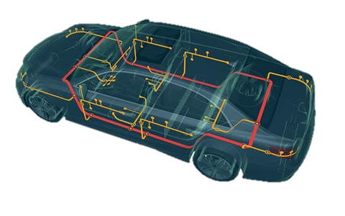
Local Interconnect network
LIN (Local Interconnect Network) is a serial network protocol used for communication between components in vehicles. The need for a cheap serial network arose as the technologies and the facilities implemented in the car grew, while the CAN bus was too expensive to implement for every component in the car.
All messages are initiated by the master with at most one slave replying to a given message identifier. The master node can also act as a slave by replying to its own messages. Because all communications are initiated by the master it is not necessary to implement a collision detection.
The master and slaves are typically
microcontrollers, but may be implemented
in specialized hardware or ASICs in order to
save cost, space, or power.

Slide 9
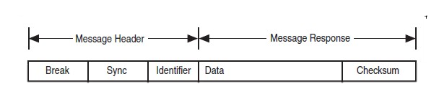
Lin Communication protocol
The LIN-Master uses one or more predefined scheduling tables to start the sending and receiving to the LIN bus. These scheduling tables contain at least the relative timing, where the message sending is initiated. One LIN Frame consists of the two parts header and response. The header is always sent by the LIN Master, while the response is sent by either one dedicated LIN-Slave or the LIN master itself.
Transmitted data within the LIN is transmitted serially as eight bit data bytes with one start bit, one stop-bit, and no parity (break field does not have a start bit and stop bit). Bit rates vary within the range of 1 kbit/s to 20 kbit/s.

Slide 10
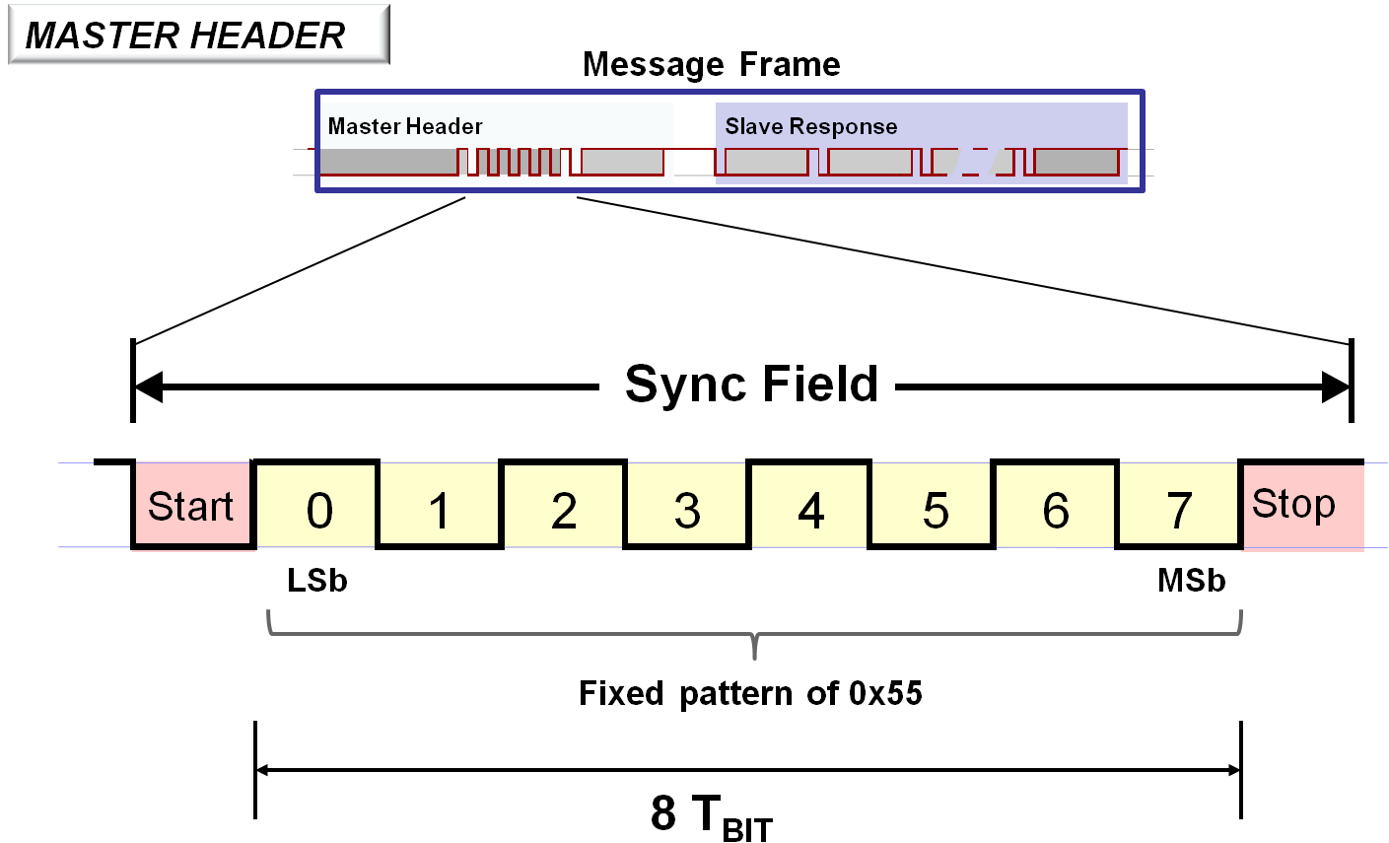
Lin Bus states
Two bus states — Sleep-mode and active — are used within the LIN protocol. While data is on the bus, all LIN-nodes are requested to be in active state. After a specified timeout, the nodes enter Sleep mode and will be released back to active state by a WAKEUP frame. This frame may be sent by any node requesting activity on the bus, either the LIN Master following its internal schedule, or one of the attached LIN Slaves being activated by its internal software application. After all nodes are awakened, the Master continues to schedule the next Identifier.

Slide 11
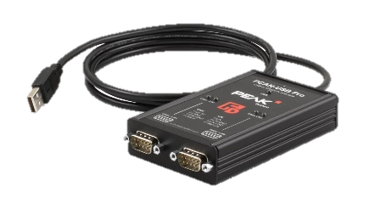
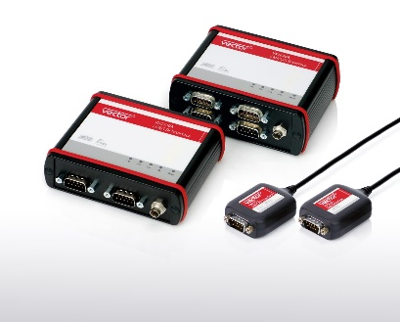
Peak and canalyzer devices
The PCAN-USB Pro adapter enables simple connection of a PC to CAN and LIN networks. Two field buses can be connected at the same time, with up to four connections available using appropriate adapter cables (2 x CAN, 2 x LIN). Its robust aluminum casing makes the PCAN-USB Pro adapter suitable for mobile applications.
CANalyzer is the comprehensive software tool with intuitive operation for analysis and stimulation of network communication. Use CANalyzer to check whether and what type of communication is occurring on the network.

Slide 12
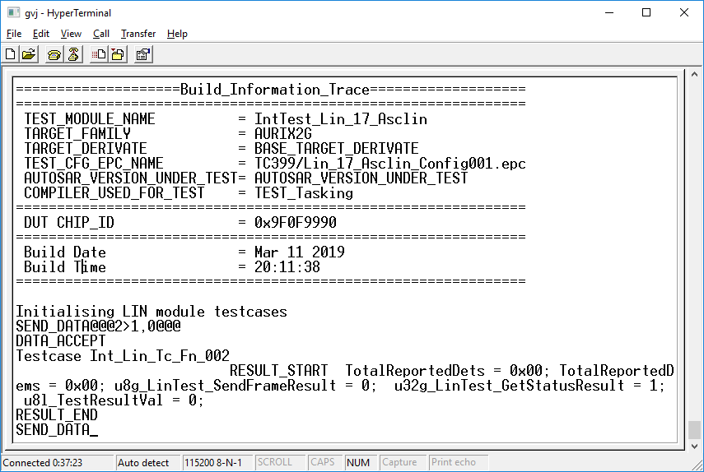
Automation of the Execution process
Automation of the execution process was done as this part was initially required for the RC 120, which was on 20th march.
This automation process included using a software called hyperterm which connects to the microcontroller over a serial port and sends data as well as the test case to be executed.

Slide 13
Getting Data on PCAN USB pro
The first step towards replacing Canalyzer with PCAN-USB Pro is to understand what its role was in the entire process. For this, we need to understand what its input and output are. Understanding the process requires repetition of the process from the start and enabling breakpoints to understand the process.
The first part of this is to understand what the Canalyzer receives and to view the same we connect PCAN-USB Pro to the LIN and CAN bus of the DUT. As this is being done specifically for the LIN module first, the initial code will be more of specialized function to support the LIN module and then generalize it later on. The PCAN-USB Pro has specifically 2 different gui applications for viewing the data that comes on the bus. They are
Pcan View
Plin View pro

Slide 14
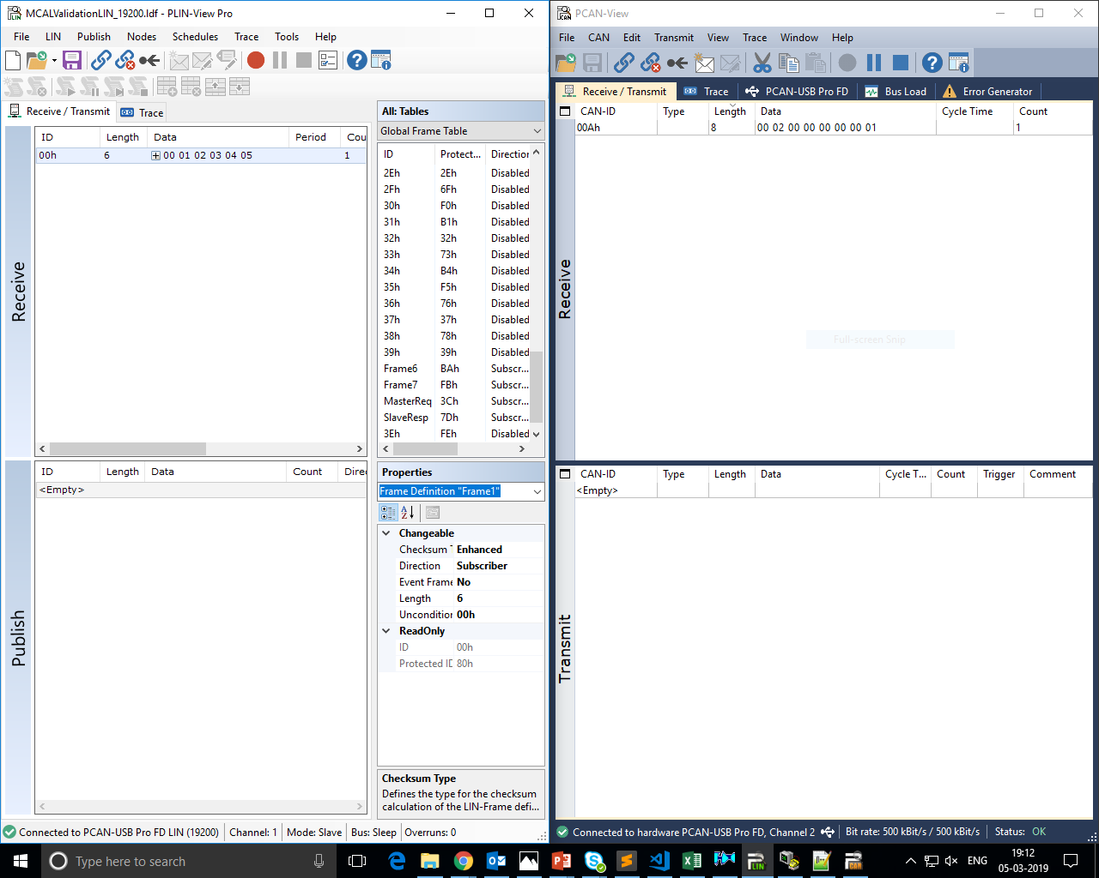

Slide 15
Frame work outline
ASE - PC
DUT
Canalyzer
@@@
USB
CAN
Check if received config ID is of a relevant test case
LIN
M -> S : Data
e.g CAPL validate bytes
CAN
USB
Pass / Fail

Slide 16
Lin message validation
The can message is sent for validation purposes as initially CAN bus was used to validate the lin data. This feature is further depreceated. The Lin data sends the test case id along with start or stop bit. That is as follows
0 | 2 | 0 | 0 | 0 | 0 | 0 | 1
Test case id
Start/stop bit

Slide 17
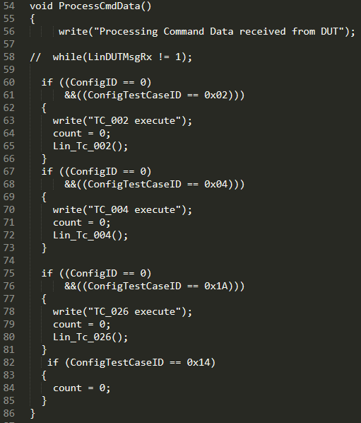
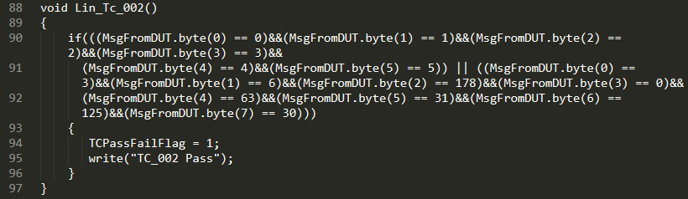
Lin message validation (Contd.)
Can config id Interpretation

Slide 18
Writing XML config files for peak and can lib
The Libraries when initialized are required to be configured with certain parameters like id , com port , slave device , baud rate etc.
Lin Config Xml
The lin config xml is given below –
The given ldf file has all the stored configuration of the data required to be sent or put into master’s sent frame and we use this ldf file to configure the lin channel of the peak device.
The config has the following parameters
Channel – The channel represents the type of configuration of the lin channel
ChannelReference – channel number
Uid – Unique Identification number for a peak device
Driver name – Driver to be used for interface with peak device’s lin channel
Baudrate - Rate of transmission of messages
Mode – Identification of operating mode of the channel (Master or slave)
LDF – Path to the ldf file required for configuration

Slide 19
Can Config Xml
The can config xml is given below –
The config has the following parameters
Channel id – This is the ID using which a specific peak device is selected with the given id
Driver name – Driver name is the driver to be used along with peak for interface of the particular library
HWChannel – Thid has id name as physical representation of the channel being used
Uid – This is the device identification number specific to every peak device
Baudrate – Rate of transmission of messages

Slide 20
Results and Discussions
As we can clearly observe from the comparison slide that the rise time of PID is far better than rise time of MRAC.
On the other hand the ability of MRAC to maintain stability of a system without any harmonics or the ability to withstand perturbation is higher as compared to PID.
This conclusion can be verified from the outputs of the simulation.
Thus proving that a hybrid controller would prove to be the best of both controllers while compensating each others disadvantages.

Slide 21
Motivation
The usage of a complex adaptive algorithm such as MRAC is already very less. Mostly due to the very less change in output results is efficiency as shown in the previous comparison.
If we can establish that the change of effectiveness is very drastic between a simple PID approach and a hybrid approach (both PID and MRAC), This will compel the industry towards a much more efficient and effective algorithm with a higher range of stable and fast operation
What is now being used in fighter jets, nuclear plants can be used in simpler applications such as in automotive industry , CNC machining etc.

Slide 22
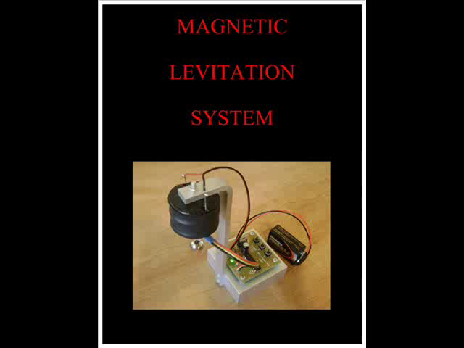
Objectives
Direct and indirect derivation of control law for modern reference adaptive control.
Implementation and analysis of a second order magnetic levitation system
PID control and analysis on the same
Simulation of the system in real time
Hybrid of both controllers and analysis of the result

Slide 23
Progress and Deadlines
Progress –
Started indentation process for procurement of materials
Derivation of non linear model equation of magnetic levitation system
Generation of control law using indirect MRAC technique for magnetic levitation system (currently pursuing)
Deadlines –
Simulation of indirect MRAC and simulink
modelling – December 2018
Real time implementation on a magnetic levit-
ation system and comparison – March 2019

Slide 24
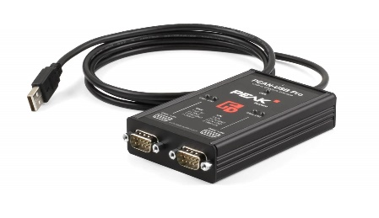
Components -
Aurix TC3xx
Peak PCAN – USB Pro
Canalyzer
Hyper Term
Robot Framework

Slide 25
References
[1] Priyank Jain, M. J. Nigam, "Design of a Hybrid Controller using Differential Evolution and MIT Rule for Magnetic Levitation System", International Journal of Scientific Research Engineering & Technology (IJSRET), Volume 3 Issue 1, April 2014.
[2] Zi-Jiang Yang, Michitaka Tateishi, "Adaptive robust nonlinear control of a magnetic levitation system", 14th World Congress of IFAC of Elsevier, July 5, 1999.
[3] Priyank Jain and M.J. Nigam, "Design of a Model Reference Adaptive Controller Using Modified MIT Rule for a Second Order System", Advance in Electronic and Electric Engineering, Volume 3, number 4, pp. 477-484, 2013.
[4] Roman Kamnik, Drago Matko and Tadej Bajd, "Application of Model Reference Adaptive Control to Industrial Robot Impedance Control", Journal of Intelligent and Robotic Systems. Vol. 22, issue 2:153-163 (1998).
[5] D. Cho, Z. Kato, D. Spilman, "Sliding Mode and Classical Control of Magnetic Levitation System", IEEE Control System, vol. CS-M, pp. 42-48, 1993.

Slide 26
[6] Abhinesh Kumar Karosiya and Shailja Shukla," Application of MRAC techniques to the PID Controller for nonlinear Magnetic Levitation System Using Kalman Filter", Journal of Control Theory and Informatics, Vol 2, No.3, 2012.
[7] Swarnkar Pankaj, "Comparative Analysis of MIT Rule and Lyapunov Rule in Model Reference Adaptive Control Scheme", Journal of Innovative Systems Design and Engineering, Vol 2, No 4, 2011.
[8] Karl Johan Astrom, Bjorn Wittenmark, Adaptive Control, Wesiey Publishing Company, Inc, 2008.
[9] Kannan S.K., Adaptive Control of systems in cascade with saturation, School of Aerospace Engineering, Georgia Institute of Technology, 2005
[10] Pratt, Roger W., Flight Control SystemsPractical Issues in Design and Implementation, 2000, Institution of Engineering and Technology
[11] Tripathi S.M., A course in Modern Control System, Laxmi Publications (P) LTD., New Delhi, 2007
[12] Hakan Korul, Demet Canpolat Tosun, Yasemin Isik, "A Model Reference Adaptive Controller Performance of an Aircraft Roll Attitude Control System", Avionics Department, Anadolu University, 1998.
[13] Abdel Kader Maddi, Guesssoum Abderrezak and Berkani Daoued, "Applying Model Reference Adaptive Controller for Lateral Motion of Aircraft", American Journal of Applied Sciences. Vol. 7: issue 2, 2010.
[14] K. Pirabakaran, V. M. Becerra, "Automatic tuning of PID controllers using model reference adaptive control techniques", Proceedings of the 27th Annual Conference of the IEEE Industrial Electronics Society, vol. 1, pp. 736-740, Nov 2001.
[15] R. V. Monopoli, "Model reference adaptive control with an augmented error signal", IEEE Transactions on Automatic Control, vol. AC-19, pp. 474-484, 1974.

Slide 27
[16] H. Bulter, Model Reference Adaptive Control - From Theory to Practice, New York:Prentice Hall, 1992.
[17] A. Mujanovic, P. Crnosija, Z. Ban, "Determination of transient error and signal adaptation algorithm coefficients in MRAS", Proceedings of the IEEE International Symposium on Industrial Electronics ISlE'99, vol. 2, pp. 631-634, 2001.
[18] Umer Akram, Muhammad Khalid, Saifullah Shafiq, "An Advanced Control Strategy for Magnetic Levitation Train System Based on an Online Adaptive PID Controller", IEEE-GCC Conference and Exhibition (GCCCE) 2017 9th, pp. 1-9, 2017.
[19] ZHAI Wanming, ZHAO Chunfa, "Dynamics of Maglev Vehicle/Guideway Systems(i)-Magnet/Rail Interaction and System Stability[J]", Chinese Journal of Mechanical Engineering, vol. 41, no. 7, pp. 1-10, 2005.
[20] S J Joo, J H. Seo, "Design and analysis of the nonlinear feedback linearizing control for an electromagnetic suspension system[J]", Control Systems Technology IEEE Transactions on, vol. 5, no. 1, pp. 135-144, 1996.
[21] Long Zhiqiang, Hong Huajie, Zhou Xiaobing, "Research of nonlinear control for a maglev train [J]", Control Theory & Applications, vol. 20, no. 3, pp. 399-402, 2003.
[22] WU Yunfei, SHENG Rongrong, "Research of Nonlinear Control for Maglev Train[J]", vol. 27, no. 6, pp. 40-43, 2005.
[23] Qiang Chen, Siyang Zhou, Jie Li, "Magnetic flux density modelling method of a maglev system", Control Conference (CCC) 2017 36th Chinese, pp. 9960-9965, 2017.
[24] Ahmed S. Abdelrahman, Jawwad Sayeed, Mohamed Z. Youssef, "Hyperloop Transportation System: Analysis Design Control and Implementation", Industrial Electronics IEEE Transactions on, vol. 65, no. 9, pp. 7427-7436, 2018.
[25] ZHONG Qiuhai, "Modern control theory [M]" in, BEIJING: Higher Education Press, pp. 395-396, 2004.
[26] LONG Xinlin, SHE Longhua, CHANG Wensen, "Study on nonlinear control method for Hybrid EMS maglev train[J]", Journal of the China Railway Society, vol. 33, no. 9, pp. 36-39, 2011.

